Slide 1
Seminar on STEGANOGRAPHY
Submitted By:
Shubham Bairagi 151112217

Slide 2
AIM:
STEGANOGRAPHY USING ALL THE THREE PLANES OF RGB IMAGE

Slide 3
Domain
Digital Image Processing:
Steganography:
-Steganography is the hiding of a secret message within an ordinary message and the extraction of it at its destination.
Image Enhancement:
-The image can be enhanced using filter which sharpen and smoothen the image.
-Splitting the image into RGB planes
-Implementing IQR(Inter Quartile Range)

Slide 4
IQR
In descriptive statistics, the interquartile range (IQR), also called the mid spread or middle 50%, or technically H-spread, is a measure of statistical dispersion, being equal to the difference between 75th and 25th percentiles, or between upper and lower quartiles, IQR = Q₃ − Q₁.
In this Project, IQR is used for deciding how many no. of bits of a message should be embedded in one byte(1 pixel of green plane)

Slide 5
Steps for finding IQR
Step 1: Put the numbers in order. 1, 2, 5, 6, 7, 9, 12, 15, 18, 19, 27.
Step 2: Find the median. 1, 2, 5, 6, 7, 9, 12, 15, 18, 19, 27.
Step 3: Place parentheses around the numbers above and below the median. Not necessary statistically, but it makes Q1 and Q3 easier to spot. (1, 2, 5, 6, 7), 9, (12, 15, 18, 19, 27).
Step 4: Find Q1 and Q3 Think of Q1 as a median in the lower half of the data and think of Q3 as a median for the upper half of data. (1, 2, 5, 6, 7), 9, ( 12, 15, 18, 19, 27). Q1 = 5 and Q3 = 18.
Step 5: Subtract Q1 from Q3 to find the interquartile range. 18 – 5 = 13.

Slide 6
STEPS(Embedding Process):
1. Split the image into RGB planes.
2. All these planes are splitted to 2*2 blocks.
3. Blue Plane is used as indicator.
4. Red Plane is used for deciding the no.of bits to be embedded in one block.
5. Green Plane is used for hiding the secret information.

Slide 7
STEPS(Extracting Process)
Take the stego image, split it into 3 separate planes.
All these planes are splitted to 2*2 blocks.
Select Blue plane and extract indicator value.
Find the no.of bits using Red plane.
Extract the message from Green Plane.

Slide 8
Embedding Process:
The image A is a cover image in the secret message in the form of binary data is to be embedded. Split the image into 3 planes RGB. Red plane is used as the carrier which gives the number of bits that are used in the green plane .Green plane is used as the carrier of the secret data.Blue plane is used as an indicator plane.

Slide 9
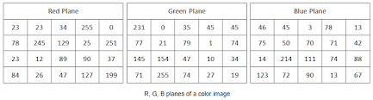
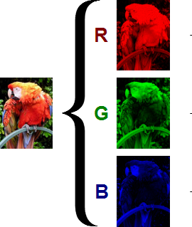
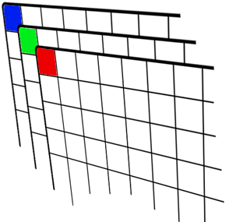
RGB planes of a color image

Slide 10
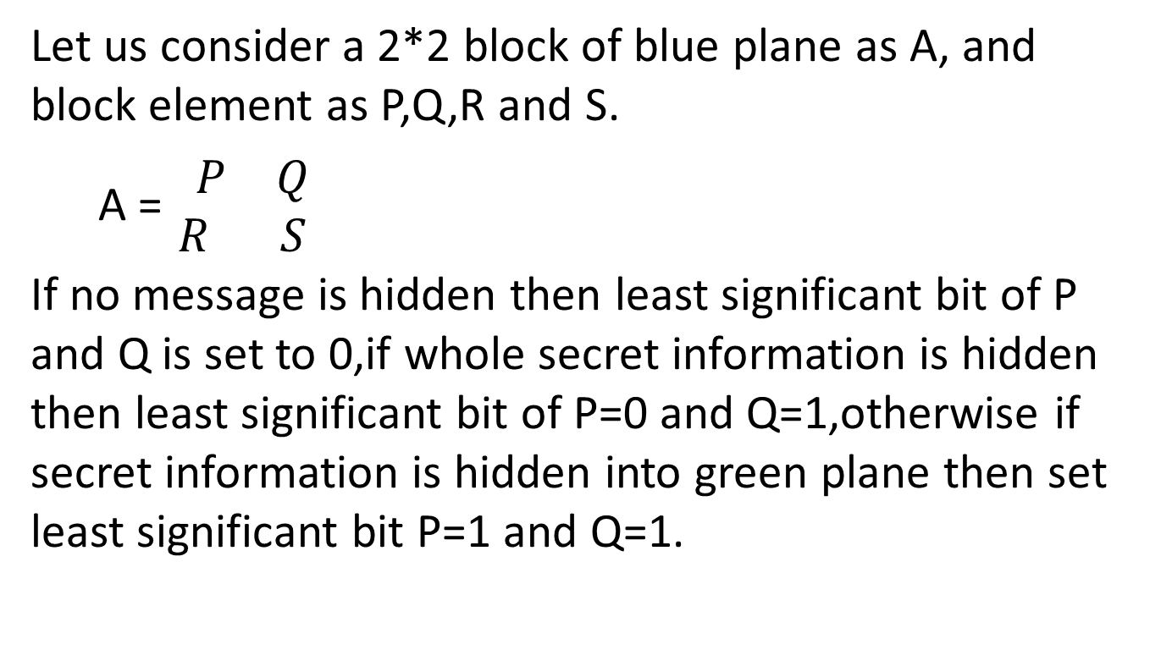
Let us consider a 2*2 block of blue plane as A, and block element as P,Q,R and S.
A =$\begin{matrix} P & Q \\ R & S\end{matrix}$
If no message is hidden then least significant bit of P and Q is set to 0,if whole secret information is hidden then least significant bit of P=0 and Q=1,otherwise if secret information is hidden into green plane then set least significant bit P=1 and Q=1.

Slide 11
Blue plane indictor
P=0,Q=0 No message
P=0,Q=1 whole message is hidden
P=1, Q=1 Message is in the Green plane.
Log function is applied on each element of 2*2 block of red plane.Di is 2*2 block of red plane.
Ri=log2(Di) ,where i=1,2,3 and 4.
If R value is greater than 6, than no message will embed into green plane and set indicator at blue plane P=0,Q=0.If value of R is less than 6,then first set indicator value into blue plane P=1,Q=1.

Slide 12
Now, find IQR value of block Ri.
If value of IQR as 0 <= IQR <= 2 then k=1
If value of IQR as 2 <= IQR <= 3.99 then k=2
If value of IQR as 4 <= IQR <= 5.99 then k=3.
K will decide the number of bits to be embedded in that particular block of green plane.
Update the last two bit of P of red plane = K
If k=1 ,P=01 if k=2 ,P=10 , k=3 ,P=11.
If whole message is embedded than set indicator value into blue plane P=0,Q=1.

Slide 13
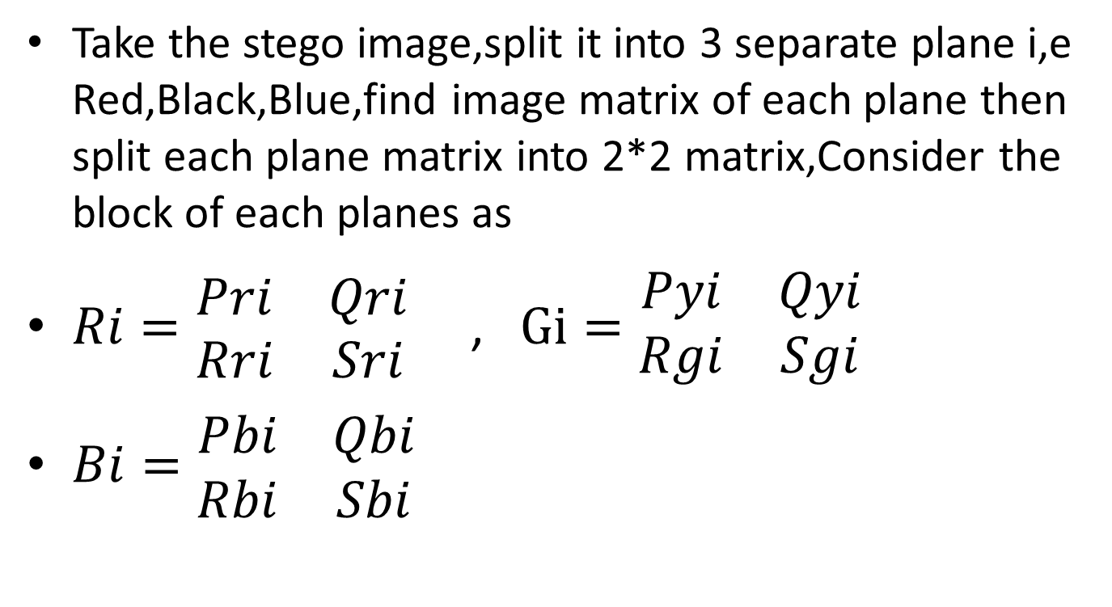
Extracting Process
Take the stego image,split it into 3 separate plane i,e Red,Black,Blue,find image matrix of each plane then split each plane matrix into 2*2 matrix,Consider the block of each planes as
$Ri=\begin{matrix}Pri & Qri \\ Rri & Sri\end{matrix}$ , $Gi=\begin{matrix}Pyi & Qyi \\ Rgi & Sgi\end{matrix}$
$Bi=\begin{matrix}Pbi & Qbi \\ Rbi & Sbi\end{matrix}$

Slide 14
Select blue plane and extract indicator value if value Pbi=0,Qbi=0 it means there were no message embedded into green plane and move on to next 2*2 matrix.
if value of Pbi=1, Qbi=1 then there is embedded message into green plane of 2*2 matrix ,therefore ,find the number of bits K which is stored in the red plane of 2*2 matrix i,e last 2 bits of element Pri.

Slide 15
Extracting
If value of K=1 then extract 1 bit from each element of 2*2 matrix of green plane.
If value of K=2 then extract 2 bit from each element of 2*2 matrix of green plane.
If value of K=3 then extract 3 bit from each element of 2*2 matrix of green plane.
If value of indicator P=0,Q=1, means there is no secret message. In this way the message is extracted from the cover image.

Slide 16
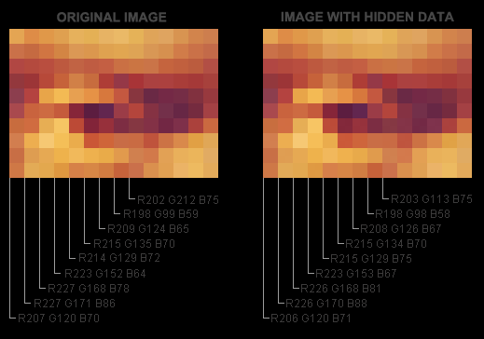
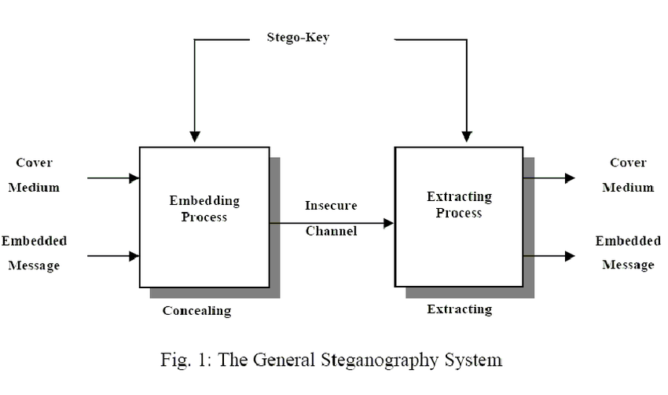
Process

Slide 17
Why This algorithm is better than other algorithms
1. We are not using any Stego-Key , So the security is high.
2. Only least significant bits are used for embedding the message , So the change in Real image is very little .
3. In this algorithm all the three plane are useful for embedding the Message.
4. Time complexity is Low , because we are using the blue plane as an indicator , If value of indicator P=0,Q=1, means there is no secret message. In this way the message is extracted from the cover image. And it will be the end point of the algorithm.
5. IQR is used for deciding how many bits of green plane will be used for embedding the message.

Slide 18
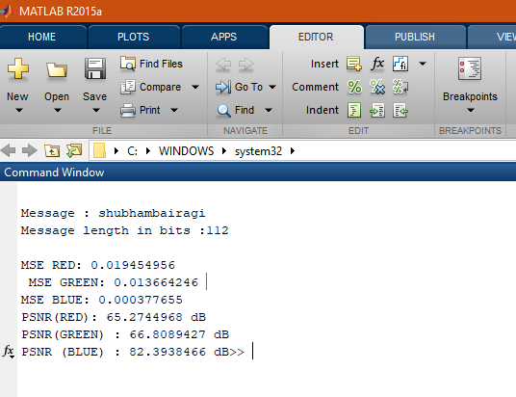
Result for Lena image (using IQR+Log2)

Slide 19
THANK YOU

